Slide 1
Causal Effect of r/WallStreetBets on Stock Price and Volume
By Takoda Denhof, Brandon Rudolph, and Chris Toomey

Slide 2
Background
WallStreetBets (WSB)
An online forum for discussing stocks
In January of 2021, retail traders on the forum were encouraged to continue buying an overvalued stock, GameStop, thus prompting a “short squeeze”
Short squeeze
Traders can bet on the price of a stock to fall, which is known as shorting the stock
Hedge funds shorted GameStop, believing it to be overvalued, while the collective actions of the users of WSB drove the price of the stock up
When the stock continued to rise, the hedge funds were forced to buy the stock in order to recoup some of their losses.
Notes:
Takoda

Slide 3
Motivation
Though GameStop is the most famous recent example, WSB constantly encourages retail traders to buy certain stocks and sell others
For our project, we wanted to see:
If appearing on the forum has a causal effect on a stock’s price compared to companies not on the forum and,
If there is a relationship between the number of mentions of a stock on WSB and the price of the stock (the marginal effect of each additional mention)
Notes:
Takoda

Slide 4
Hypothesis
Let Y be the percent difference of the return of a stock over the period February 4, 2021 and February 18, 2021 and let A be the treatment that a stock is displayed on SwaggyStocks.com on February 11, 2021:
H_{o}: E[Y | A=1] = E[Y | A=0]
H_{a}: E[Y | A=1] ≠ E[Y | A=0]
Notes:
Takoda

Slide 5
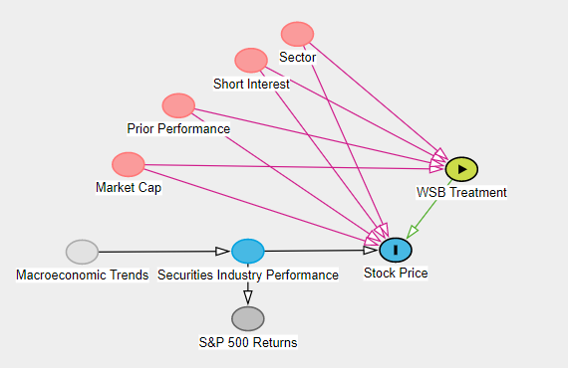
Study Design
An observational study where we try to mitigate the effect of potential confounders and use regression analysis in order to see how the number of mentions on WSB affects a stock’s price
Use Inverse Probability Weighting and Propensity Score Matching to eliminate confounding bias
Run a linear regression model to analyze the marginal effect of each additional mention
Notes:
Takoda

Slide 6
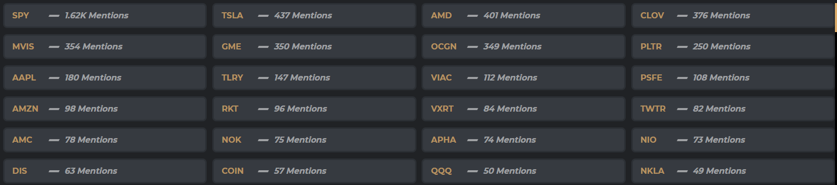
Data Acquisition
YFinance
Python API that holds information on companies at certain times, such as their market cap and P/E ratio
SwaggyStocks
Website that contains the number of mentions a specific stock has on WSB over a certain time frame
Wayback machine
Web tool to find what information a URL had at a certain time
Used in this project in order to obtain data from SwaggyStocks in our specified time frame
Notes:
Chris

Slide 7
Causal Effect Measures
Causal risk difference
E[Y^{a=1}] - E[Y^{a=0}]=0
E[Y^{a=1}| L=l] - E[Y^{a=0}| L=l]=0 where L represents confounding features of a subject
Causal risk ratio
E[Y^{a=1}]/E[Y^{a=0}]=1
E[Y^{a=1}| L=l] / E[Y^{a=0}| L=l]=1 where L represents confounding features of a subject
We are using these two measures because they help us determine the strength of the causal effect on both the additive and multiplicative scales
Notes:
Chris

Slide 8
Analysis
Unweighted Regression vs IP Weighting
This helps mitigate confounding bias that may affect the likelihood of the treatment
Propensity score
Use matching in our analysis to compare subjects that were equally likely to be treated and untreated given the confounders
Linear regression for those who were treated
In order to see if the number of mentions had any effect on the price, rather than just whether the stock was mentioned
Notes:
Chris

Slide 9
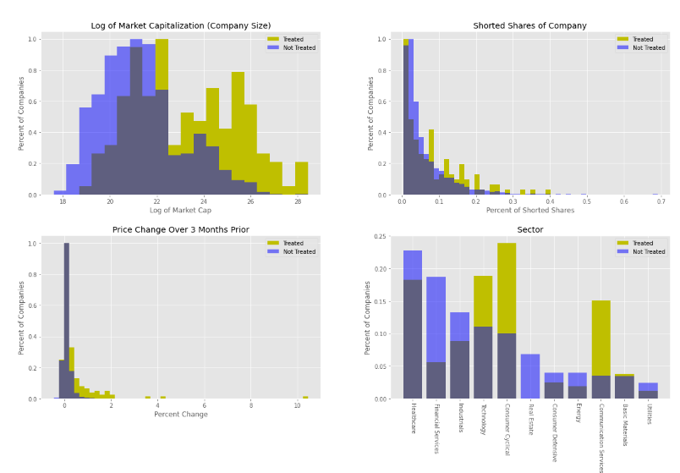
Propensity Scoring Inputs

Slide 10
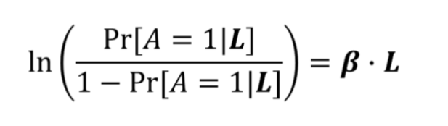
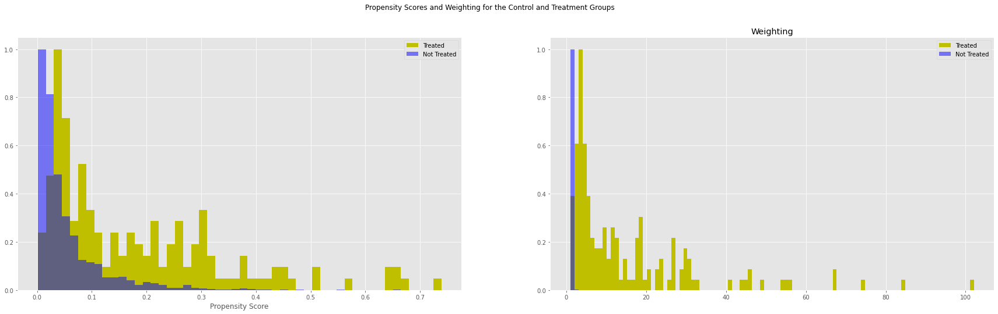
Propensity Scores and Weightings
(Where L includes the Covariates of Market Capitalization, Short Percentage, Past Performance, and Sector)

Slide 11
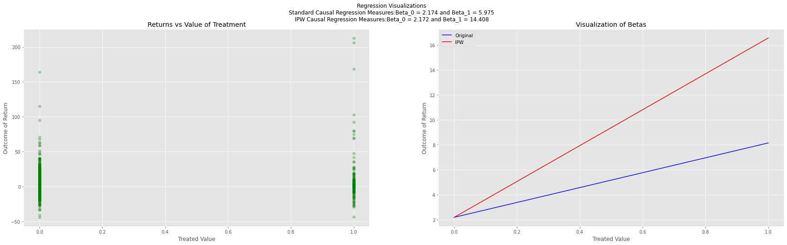
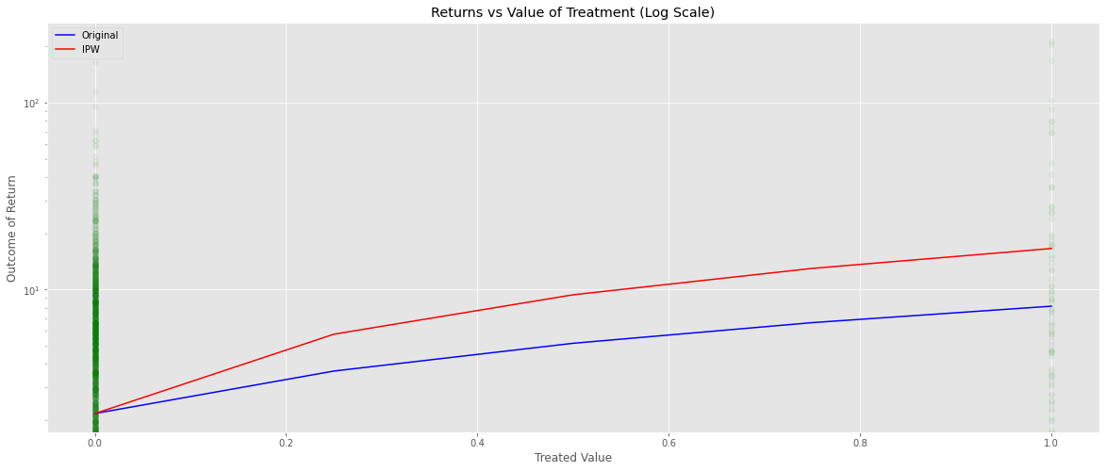
Plain Vanilla and IPW Causal Regression Results

Slide 12
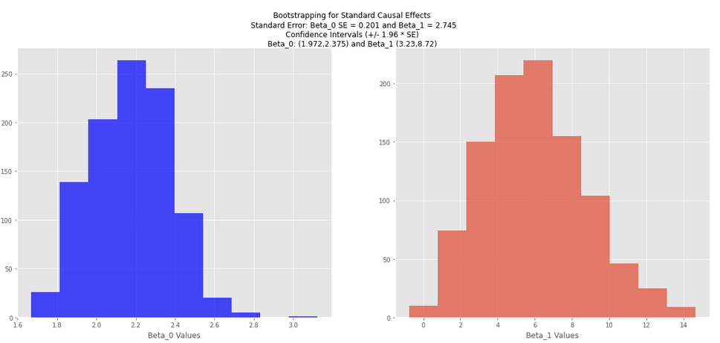
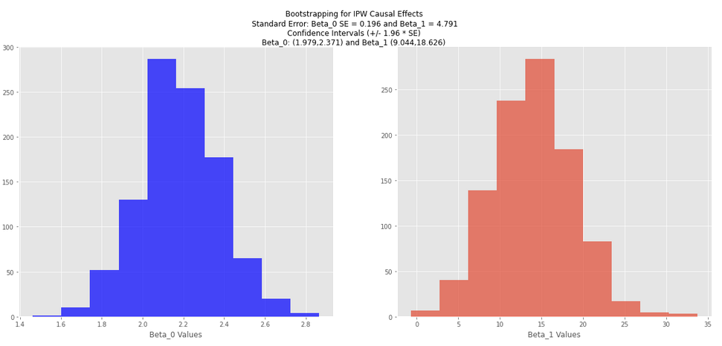
Bootstrapping
Run 1,000 trials of samples of same size as the dataset
For each sample, we calculate the intercept of regression (return for control) and slope of regression (causal effect)
Standard regression (top) and IPW regression (bottom) results

Slide 13
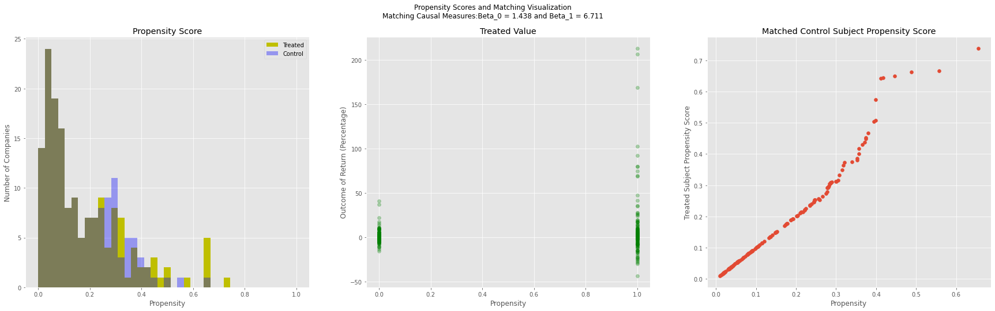
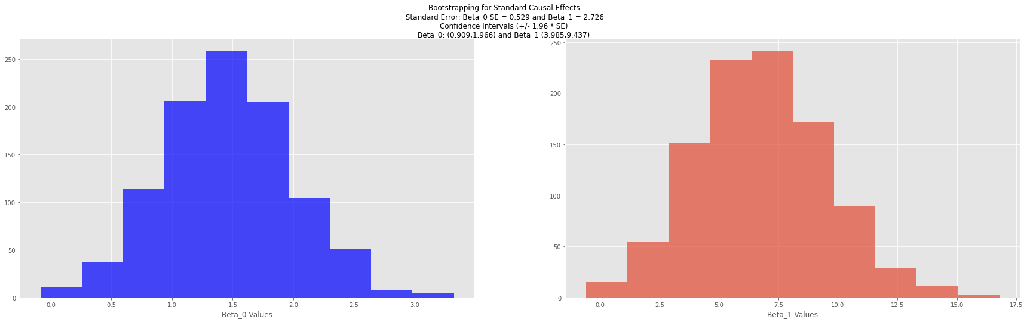
Results of Propensity Score Matching

Slide 14
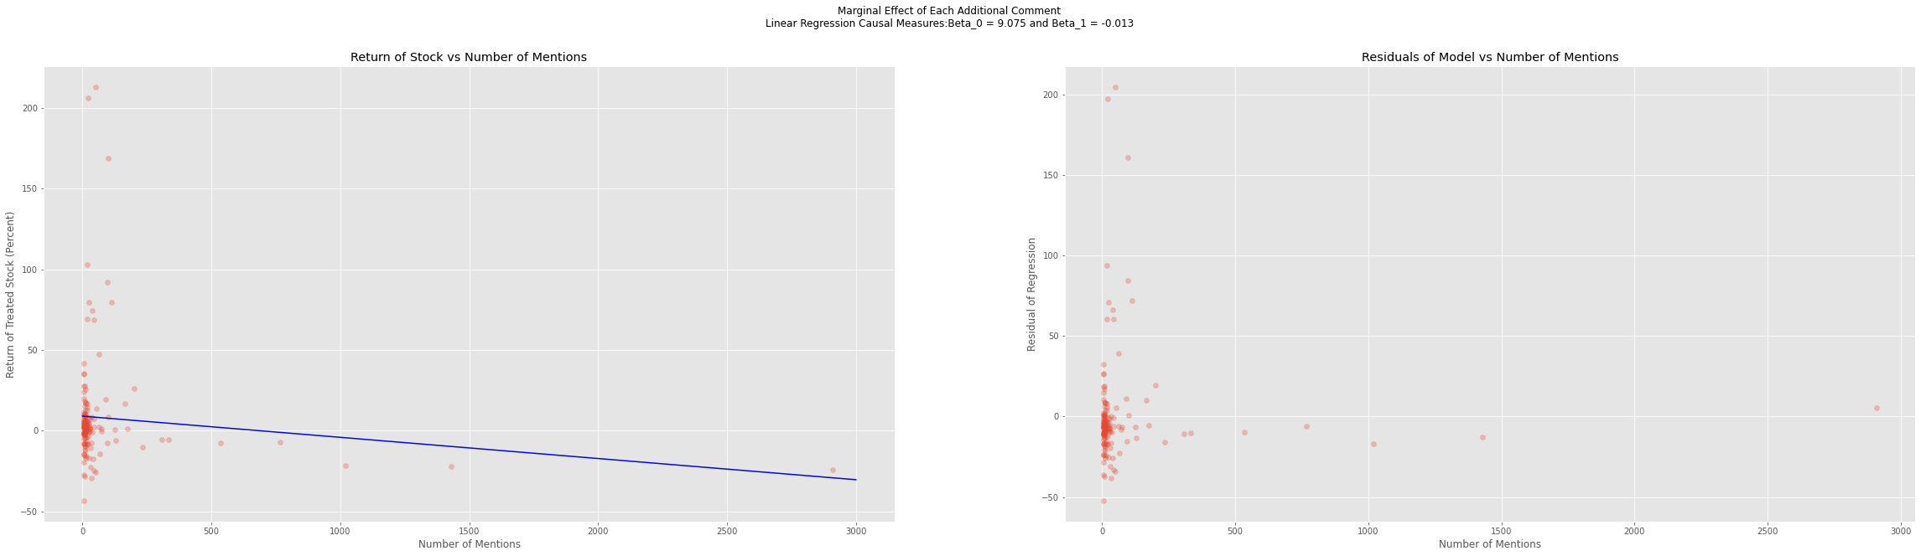
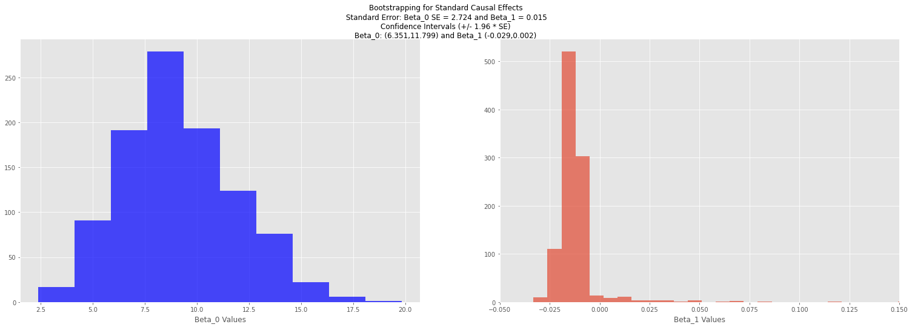
Results of Marginal Effect of Comment Volume

Slide 15
RESULTS:
Standard Regression:
E[Y|A=1] (𝛽₁+ 𝛽₀)= 8.114%
E[Y|A=0] (𝛽₀)= 2.174%
Additive Causal Effect: E[Y|A=1] - E[Y|A=0]= 5.975%
Confidence Interval (𝛽₁): (3.23, 8.72)
Multiple Causal Effect: E[Y|A=1] / E[Y|A=0]= 3.73
IPW Regression:
E[Y|A=1] (𝛽₁+ 𝛽₀)= 16.58%
E[Y|A=0] (𝛽₀)= 2.172%
Additive Causal Effect (𝛽₁) : E[Y|A=1] - E[Y|A=0]= 14.408%
Confidence Interval (𝛽₁): (9.044, 18.626)
Multiple Causal Effect: E[Y|A=1] / E[Y|A=0]= 7.634
Matching Regression:
E[Y|A=1] (𝛽₁+ 𝛽₀)= 8.149%
E[Y|A=0] (𝛽₀)= 1.438%
Additive Causal Effect (𝛽₁): E[Y|A=1] - E[Y|A=0]= 6.711%
Confidence Interval (𝛽₁): (3.985, 9.437)
95% confidence interval does not encompass zero
Multiple Causal Effect: E[Y|A=1] / E[Y|A=0]= 5.667
Marginal Effect of Mentions Regression:
𝛽₁= -.015%
Confidence Interval (𝛽₁): (-.029, .002)
Since the 95% confidence interval includes zero, we reject the notion that additional mentions has an effect on a treated company’s price

Slide 16
Conclusion
Given the observed variables, by mitigating confounding bias using IP weighting and propensity scores, we were able to observe a causal effect on whether a stock was mentioned on WSB and its price
Standardization
Additive: 5.975%, Multiplicative: 3.73
IP Weighting:
Additive: 14.408%, Multiplicative: 7.634
Propensity Score:
Additive: 6.711%, Multiplicative: 5.667
Using the assumption that there were no unobserved variables
Each additional mention, however, did not conclusively increase the price of the stock

